Slide 1

VTO tutorial
Play the SlideShow and clic to advance

Slide 2
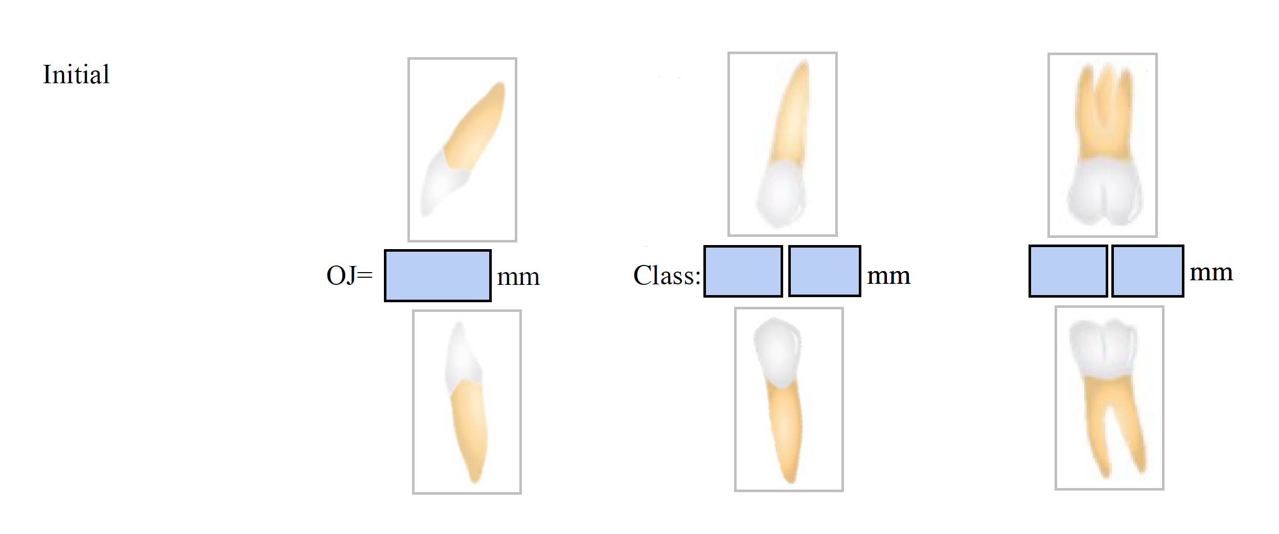
Enter Canine Class
Enter Class in mm
Enter OJ in mm
Enter Molar Class
Enter Class in mm

Slide 3
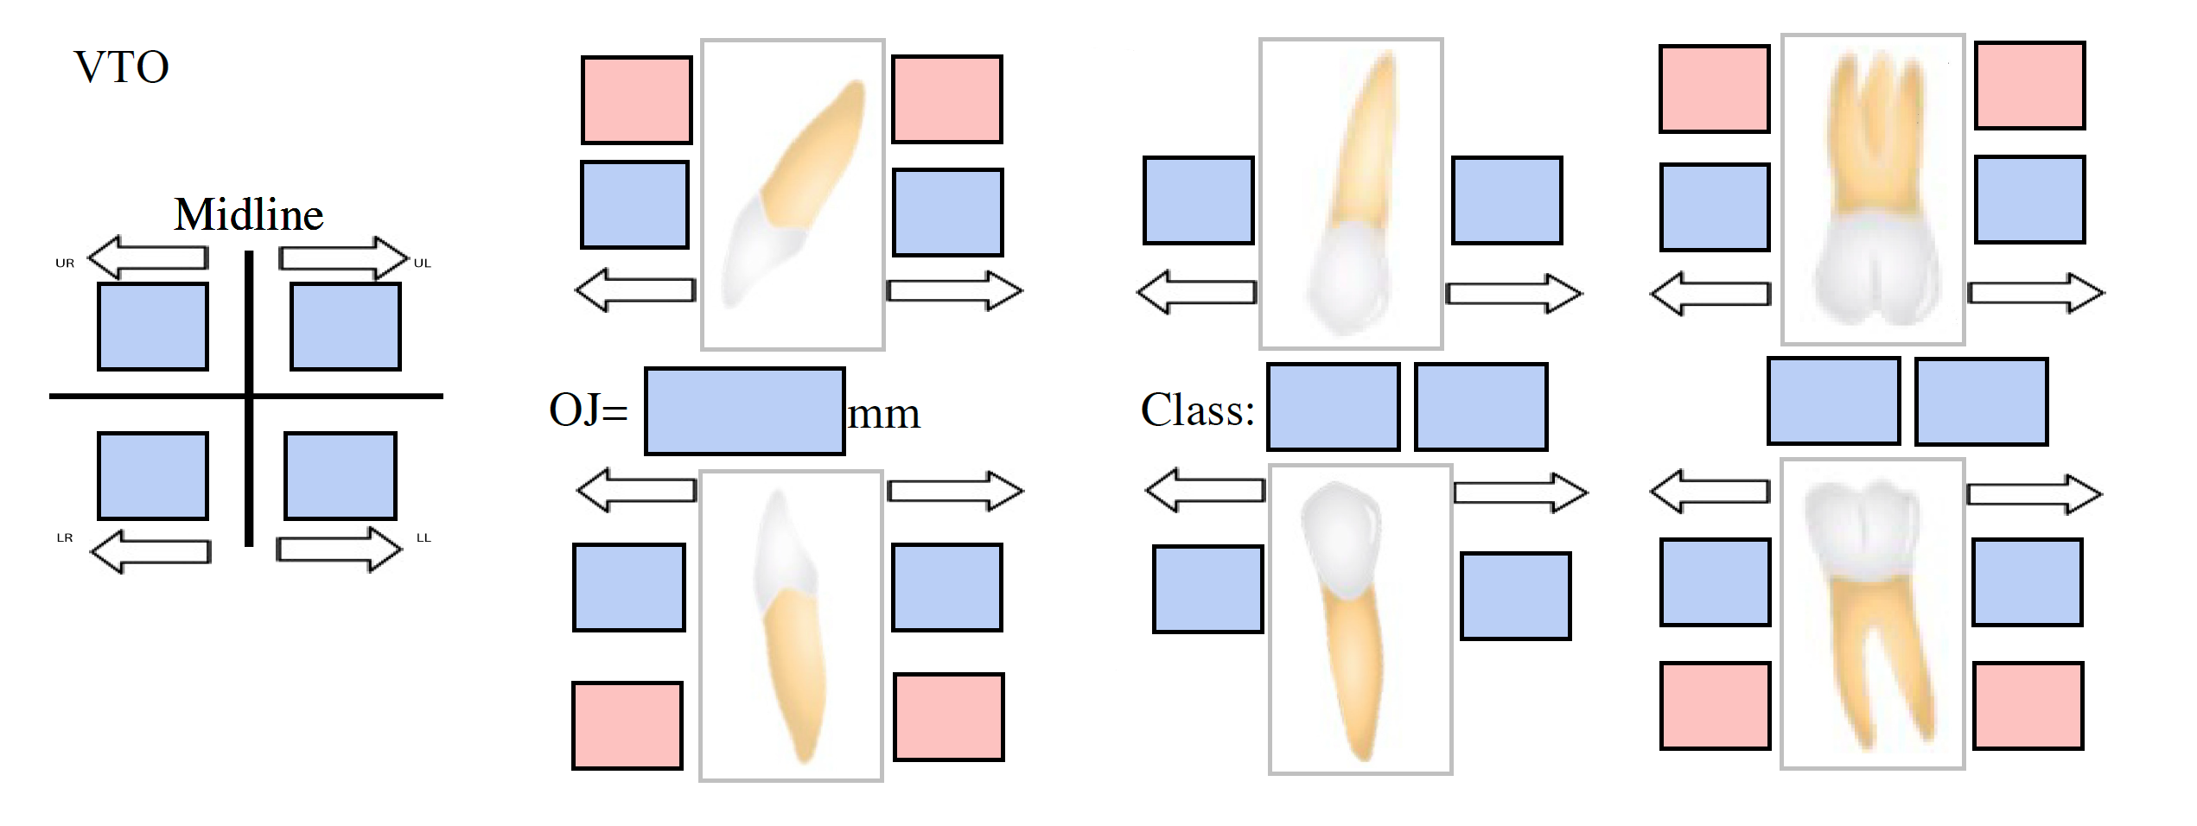
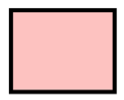

Enter planned OJ
Enter planned Class canine mm if applicable
Enter planned Class molar mm if applicable
Enter planned Protraction or retraction for upper teeth
Enter midlines movements
mm
mm
Enter planned Protraction or Retraction for lower teeth
Movements from growth or surgery
Dental Movements

Slide 4
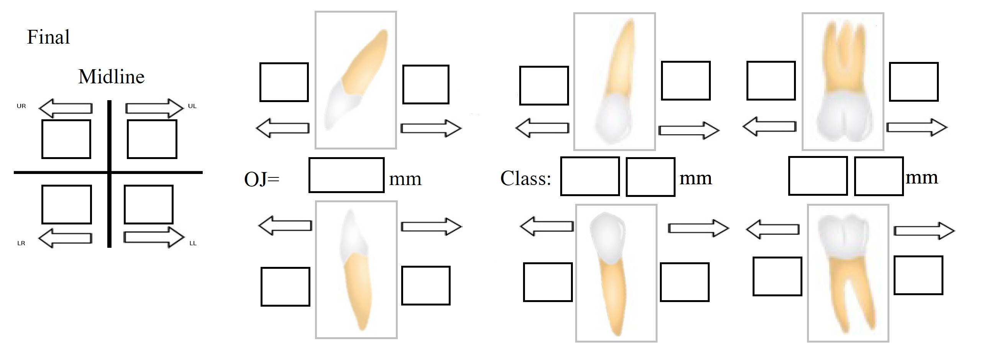
Enter resulting OJ
Enter resulting Class canine mm if applicable
Enter resulting Class molar mm if applicable
Enter resulting Protraction or Retraction for upper teeth
Enter midlines movements achieved
Enter resulting Protraction or Retraction for lower teeth

