Slide 1
A Case Report
In partial fulfillment
of the requirements for membership
For the Eastern Component, the E. H. Angle Society of Orthodontists
Affiliate Name:
Patient Name:
Meeting Date:

Slide 2
Case Summary
DOB/Sex/Race:
H: W:
Age at start of treatment: Y M
Date of Initial records: MM/DD/YYYY
Case Category:
Chief Complaint:
Pertinent Medical History:
Allergies:
Pertinent Dental History:
Social History:
(here insert a facial photo)

Slide 3
Case Summary Continued
Diagnostic Summary:
Summary of treatment:

Slide 4
Initial Composite photos
MM/DD/YYYY

Slide 5
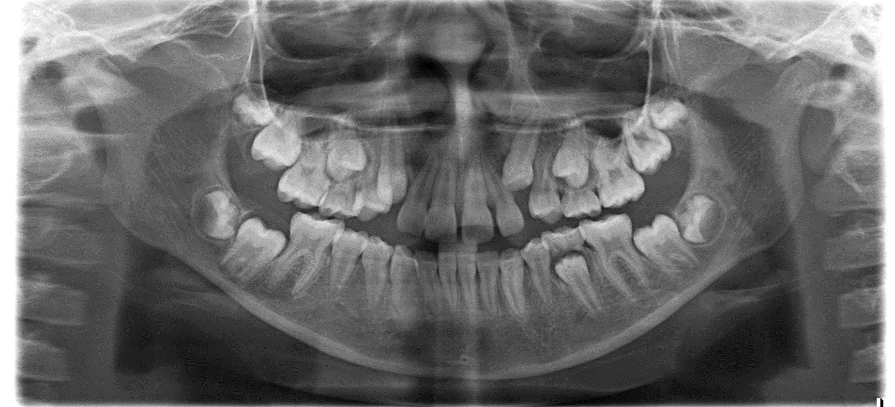
Panoramic radiograph (MM/DD/YYYY)
Please add observations here:

Slide 6
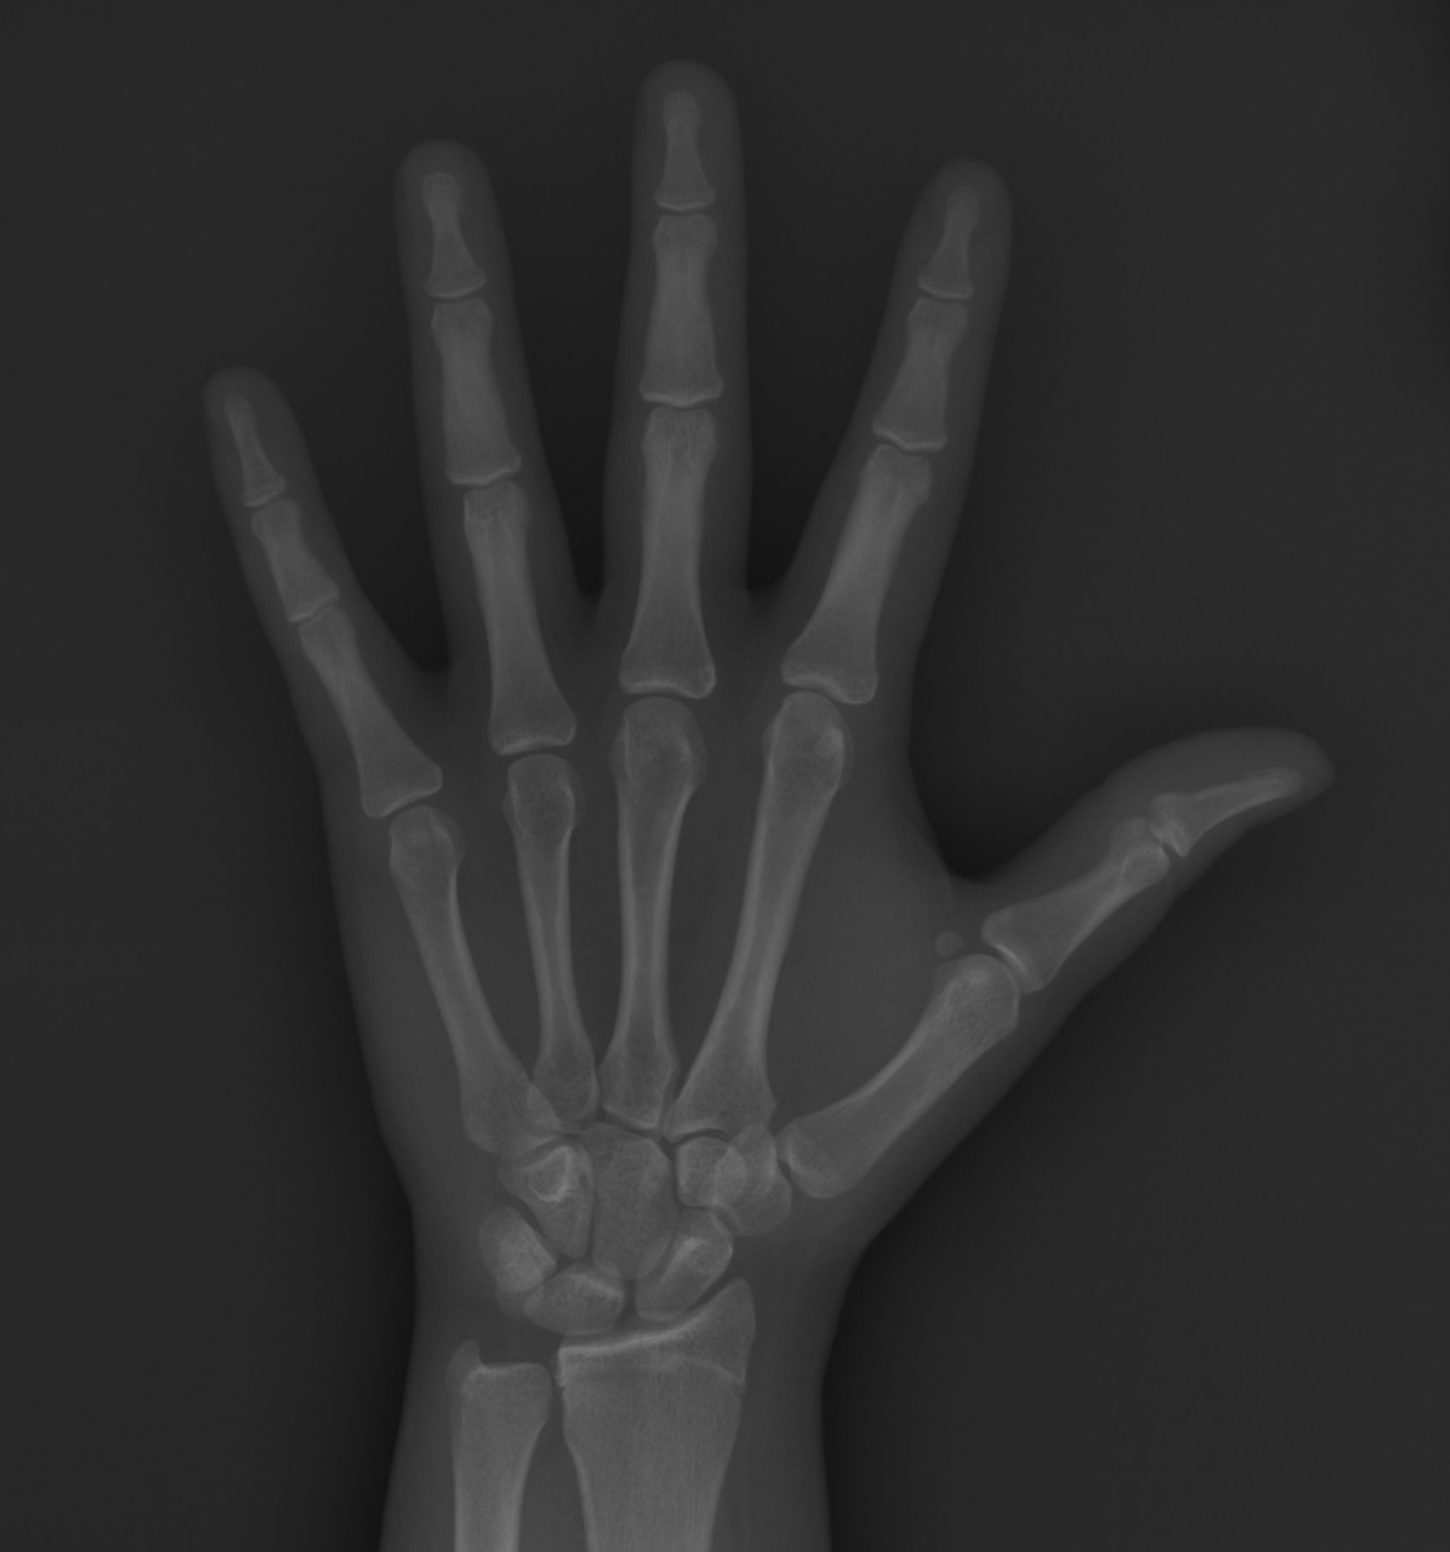
Growth Status (if <18 years of age)
SMI:
CVS:
Interpretation:

Slide 7
Initial cephalogram without tracing

Slide 8
Initial cephalogram tracing without x-ray (black)

Slide 9
Ceph Analysis
AREA OF STUDY | Norms (fill in the blanks) | Initial | Tx plan | Prog 1 | Prog 2 | Final
Cranial base
S-N mm | ± mm | mm | mm | mm | mm | mm
N-S-Ar ° | ° ± ° | ° | ° | ° | ° | °
Maxilla and mandible to cranial base
SNA ° | ° ± ° | ° | ° | ° | ° | °
SNB ° | ° ± ° | ° | ° | ° | ° | °
N-A/A-Pg ° | ° ± ° | ° | ° | ° | ° | °
N-|A (FH) mm | M: mm ± mm F: mm ± mm | mm | mm | mm | mm | mm
N-|B (FH) mm | M: mm ± mm F: mm ± mm | mm | mm | mm | mm | mm
N-|Pog (FH) mm | M: mm ± mm F: mm ± mm | mm | mm | mm | mm | mm

Slide 10
Ceph Analysis page 2
Maxillomandibular relations
A-B (OP) -Wits mm | ± mm | mm | mm | mm |  | mm
ANB ° | ° | ° | ° | ° |  | °
Size and form of the maxilla and the mandible
Condylion-ANS mm | ± mm | mm | mm | mm | mm | mm
Condylion-Pg mm | ± mm | mm | mm | mm | mm | mm
diff.: Co-Pg minus CoANS mm | mm | mm | mm | mm | mm | mm
LAFH mm | ± mm | mm | mm | mm | mm | mm
Ar-Go (Articulare-Gonion) mm | M: ± mm F: ± mm | mm | mm | mm | mm | mm
Go-Pg (Gonion-Pogonion) mm | M: ± mm F: ± mm | mm | mm | mm | mm | mm
Ar-Go-Me (Gonial Angle) ° | M: ° ± ° F: °± °mm | mm | mm | mm | mm | mm
Vertical height
SN-GoGn ° | ° ± ° | ° | ° | ° | ° | °
FMA ° | ° ± ° | ° | ° | ° | ° | °
N-ANS mm | ± mm | mm | mm | mm | mm | mm
ANS-Me mm | ± mm | mm | mm | mm | mm | mm
% ratio | / % | / | / | / | / | /
Norms
Initial
Tx plan
Prog 1
Prog 2
Final
Notes:
I suggest to split this slide

Slide 11
Ceph Analysis page 3
Maxillary and mandibular incisor position
1/-FH ° | ° ± ° | ° | ° | ° | ° | °
1/-NA ° / mm | ± ° / mm
Interincisal angle ° | ° ± ° | ° | ° | ° | ° | °
/1-NB ° / mm | ± ° / mm
/1-MP (IMPA) ° | ± ° | ° | ° | ° | ° | °
/1-APg mm | ± mm | mm | mm | mm | mm | mm
Soft tissue
UL-E plane mm | ± mm | mm | mm | mm | mm | mm
LL- E plane mm | ± mm | mm | mm | mm | mm | mm
G-Sn-Pg’ (facial convexity angle) ° | ° ± ° | ° | ° | ° | ° | °
Norms
Initial
Tx plan
Prog 1
Prog 2
Final

Slide 12
Intraoral scans (in addition to OR instead of casts)
Occlusion (molar, canine)
Maxillary arch length discrepancy (mm)
Mandibular arch length discrepancy (mm)
Other
Curve of Spee depth:
Right side:
Left side:

Slide 13
Diagnosis:
Skeletal:
Dental:
Soft Tissue:

Slide 14
Diagnosis, part 2:
TMJ :
Other issues (Bolton, Perio, etc…)

Slide 15
Specific Objectives of Treatment
Maxilla (all 3 planes):
Mandible (all 3 planes):

Slide 16
Specific Objectives of Treatment, part 2:
Maxillary dentition:
Sagittal
Vertical
Transverse
Mandibular dentition:
Sagittal
Vertical
Transverse

Slide 17
Specific Objectives of Treatment, part 3:
Occlusion:
Facial:

Slide 18
Treatment Plans
On the following slides, please detail any treatment plans that could be carried out based upon the diagnosis and treatment objectives. For each plan, discuss the advantages and limitations and why the proposed treatment plan was selected.
In discussing your treatment plan, review the influence of facial growth, treatment appliances and mechanics, and surgery, if indicated, to attain the forecasted goals. What changes do you anticipate with the soft tissue, maxillomandibular relationship and dentition in all three planes of space?
Your plan for tooth movement should be illustrated in the VTO following the treatment plans.

Slide 19
Treatment Plan Chosen
Treatment plan:
Treatment summary:
Expected treatment time:
Retention plan:
Advantages | Disadvantages

Slide 20
Alternate Treatment Plan
Treatment plan:
Treatment summary:
Expected treatment time
Retention plan:
Advantages | Disadvantages

Slide 21
Rationale:
Prognosis:

Slide 22
Interdisciplinary Management & Documentation

Slide 23
Mechanics: (give details in order of use as planned)

Slide 24
Mechanics, part 2:

Slide 25
VTO for treatment planned
Initial
Class:
mm
OJ=
mm
VTO
Midline
Class:
OJ=
mm
3
Tx Plan/objective 1/-FH or 1/-NA
1/1°
/1-MP or /1-NB
/1-A-Pog
Forward arrow indicate mesial movement. Backward arrow indicate distal movement. The box below the arrow indicates the amount of mm is the mesial or distal movement. No movement = 0. Midline: indicate which side and the amount of movement.
____________________________________________________________________________________________________________________
Final
©The Edward H. Angle Society of Orthodontists Eastern Component

Slide 26
1 year progress photos
MM/DD/YYYY

Slide 27
1 year progress panoramic radiograph (MM/DD/YYYY)

Slide 28
1 year progress cephalogram without tracing

Slide 29
1 year progress cephalogram tracing without radiograph (blue)

Slide 30
Ceph Analysis
AREA OF STUDY | Norms (fill in the blanks) | Initial | Tx plan | Prog 1 | Prog 2 | Final
Cranial base
S-N mm | ± mm | mm | mm | mm | mm | mm
N-S-Ar ° | ° ± ° | ° | ° | ° | ° | °
Maxilla and mandible to cranial base
SNA ° | ° ± ° | ° | ° | ° | ° | °
SNB ° | ° ± ° | ° | ° | ° | ° | °
N-A/A-Pg ° | ° ± ° | ° | ° | ° | ° | °
N-|A (FH) mm | M: mm ± mm F: mm ± mm | mm | mm | mm | mm | mm
N-|B (FH) mm | M: mm ± mm F: mm ± mm | mm | mm | mm | mm | mm
N-|Pog (FH) mm | M: mm ± mm F: mm ± mm | mm | mm | mm | mm | mm

Slide 31
Ceph Analysis page 2
Maxillomandibular relations
A-B (OP) -Wits mm | ± mm | mm | mm | mm |  | mm
ANB ° | ° | ° | ° | ° |  | °
Size and form of the maxilla and the mandible
Condylion-ANS mm | ± mm | mm | mm | mm | mm | mm
Condylion-Pg mm | ± mm | mm | mm | mm | mm | mm
diff.: Co-Pg minus CoANS mm | mm | mm | mm | mm | mm | mm
LAFH mm | ± mm | mm | mm | mm | mm | mm
Ar-Go (Articulare-Gonion) mm | M: ± mm F: ± mm | mm | mm | mm | mm | mm
Go-Pg (Gonion-Pogonion) mm | M: ± mm F: ± mm | mm | mm | mm | mm | mm
Ar-Go-Me (Gonial Angle) ° | M: ° ± ° F: °± °mm | mm | mm | mm | mm | mm
Vertical height
SN-GoGn ° | ° ± ° | ° | ° | ° | ° | °
FMA ° | ° ± ° | ° | ° | ° | ° | °
N-ANS mm | ± mm | mm | mm | mm | mm | mm
ANS-Me mm | ± mm | mm | mm | mm | mm | mm
% ratio | / % | / | / | / | / | /
Norms
Initial
Tx plan
Prog 1
Prog 2
Final
Notes:
I suggest to split this slide

Slide 32
Ceph Analysis page 3
Maxillary and mandibular incisor position
1/-FH ° | ° ± ° | ° | ° | ° | ° | °
1/-NA ° / mm | ± ° / mm
Interincisal angle ° | ° ± ° | ° | ° | ° | ° | °
/1-NB ° / mm | ± ° / mm
/1-MP (IMPA) ° | ± ° | ° | ° | ° | ° | °
/1-APg mm | ± mm | mm | mm | mm | mm | mm
Soft tissue
UL-E plane mm | ± mm | mm | mm | mm | mm | mm
LL- E plane mm | ± mm | mm | mm | mm | mm | mm
G-Sn-Pg’ (facial convexity angle) ° | ° ± ° | ° | ° | ° | ° | °
Norms
Initial
Tx plan
Prog 1
Prog 2
Final

Slide 33
Treatment progress
Compare treatment progress relative to the original problem list and the forecasted goals. Discuss treatment response relative to case biomechanics used. Discuss any changes or modifications of treatment that will be needed to attain your original treatment goals.
(Include exact arch wire sequence, timing, and other mechanics used)

Slide 34
Superimposition of progress (blue) to initial (black) cephalogram

Slide 35
Results achieved:
Maxilla
Mandible

Slide 36
Results achieved, part 2:
Maxillary dentition
Mandibular dentition

Slide 37
Results achieved, part 3:
Occlusion
Esthetics

Slide 38
Self-Assessment
Please describe how your planned treatment went, and if you might change anything in the future because of this.

Slide 39
2 year Composite photos
MM/DD/YYYY

Slide 40
2 year progress panoramic radiograph (MM/DD/YYYY)

Slide 41
2 year progress cephalogram without tracing

Slide 42
2 year progress cephalogram tracing without radiograph (blue)

Slide 43
Ceph Analysis
AREA OF STUDY | Norms (fill in the blanks) | Initial | Tx plan | Prog 1 | Prog 2 | Final
Cranial base
S-N mm | ± mm | mm | mm | mm | mm | mm
N-S-Ar ° | ° ± ° | ° | ° | ° | ° | °
Maxilla and mandible to cranial base
SNA ° | ° ± ° | ° | ° | ° | ° | °
SNB ° | ° ± ° | ° | ° | ° | ° | °
N-A/A-Pg ° | ° ± ° | ° | ° | ° | ° | °
N-|A (FH) mm | M: mm ± mm F: mm ± mm | mm | mm | mm | mm | mm
N-|B (FH) mm | M: mm ± mm F: mm ± mm | mm | mm | mm | mm | mm
N-|Pog (FH) mm | M: mm ± mm F: mm ± mm | mm | mm | mm | mm | mm

Slide 44
Ceph Analysis page 2
Maxillomandibular relations
A-B (OP) -Wits mm | ± mm | mm | mm | mm |  | mm
ANB ° | ° | ° | ° | ° |  | °
Size and form of the maxilla and the mandible
Condylion-ANS mm | ± mm | mm | mm | mm | mm | mm
Condylion-Pg mm | ± mm | mm | mm | mm | mm | mm
diff.: Co-Pg minus CoANS mm | mm | mm | mm | mm | mm | mm
LAFH mm | ± mm | mm | mm | mm | mm | mm
Ar-Go (Articulare-Gonion) mm | M: ± mm F: ± mm | mm | mm | mm | mm | mm
Go-Pg (Gonion-Pogonion) mm | M: ± mm F: ± mm | mm | mm | mm | mm | mm
Ar-Go-Me (Gonial Angle) ° | M: ° ± ° F: °± °mm | mm | mm | mm | mm | mm
Vertical height
SN-GoGn ° | ° ± ° | ° | ° | ° | ° | °
FMA ° | ° ± ° | ° | ° | ° | ° | °
N-ANS mm | ± mm | mm | mm | mm | mm | mm
ANS-Me mm | ± mm | mm | mm | mm | mm | mm
% ratio | / % | / | / | / | / | /
Norms
Initial
Tx plan
Prog 1
Prog 2
Final
Notes:
I suggest to split this slide

Slide 45
Ceph Analysis page 3
Maxillary and mandibular incisor position
1/-FH ° | ° ± ° | ° | ° | ° | ° | °
1/-NA ° / mm | ± ° / mm
Interincisal angle ° | ° ± ° | ° | ° | ° | ° | °
/1-NB ° / mm | ± ° / mm
/1-MP (IMPA) ° | ± ° | ° | ° | ° | ° | °
/1-APg mm | ± mm | mm | mm | mm | mm | mm
Soft tissue
UL-E plane mm | ± mm | mm | mm | mm | mm | mm
LL- E plane mm | ± mm | mm | mm | mm | mm | mm
G-Sn-Pg’ (facial convexity angle) ° | ° ± ° | ° | ° | ° | ° | °
Norms
Initial
Tx plan
Prog 1
Prog 2
Final

Slide 46
Treatment progress- 2 years (MM/DD/YYYY)
Compare treatment progress relative to the original problem list and the forecasted goals. Discuss treatment response relative to case biomechanics used. Discuss any changes or modifications of treatment that will be needed to attain your original treatment goals.
(Include exact arch wire sequence, timing, and other mechanics used)

Slide 47
2 year progress results achieved:
Maxilla
Mandible

Slide 48
2 year progress results achieved, part 2:
Maxillary dentition
Mandibular dentition

Slide 49
2 year progress results achieved, part 3:
Occlusion
Esthetics

Slide 50
Self-Assessment
Please describe how your planned treatment went, and if you might change anything in the future because of this.

Slide 51
Final Composite photos
MM/DD/YYYY

Slide 52
Final panoramic radiograph (date MM/DD/YYYY)

Slide 53
Final cephalogram without tracing

Slide 54
Final cephalogram tracing without radiograph (blue)

Slide 55
Ceph Analysis
AREA OF STUDY | Norms (fill in the blanks) | Initial | Tx plan | Prog 1 | Prog 2 | Final
Cranial base
S-N mm | ± mm | mm | mm | mm | mm | mm
N-S-Ar ° | ° ± ° | ° | ° | ° | ° | °
Maxilla and mandible to cranial base
SNA ° | ° ± ° | ° | ° | ° | ° | °
SNB ° | ° ± ° | ° | ° | ° | ° | °
N-A/A-Pg ° | ° ± ° | ° | ° | ° | ° | °
N-|A (FH) mm | M: mm ± mm F: mm ± mm | mm | mm | mm | mm | mm
N-|B (FH) mm | M: mm ± mm F: mm ± mm | mm | mm | mm | mm | mm
N-|Pog (FH) mm | M: mm ± mm F: mm ± mm | mm | mm | mm | mm | mm

Slide 56
Ceph Analysis page 2
Maxillomandibular relations
A-B (OP) -Wits mm | ± mm | mm | mm | mm |  | mm
ANB ° | ° | ° | ° | ° |  | °
Size and form of the maxilla and the mandible
Condylion-ANS mm | ± mm | mm | mm | mm | mm | mm
Condylion-Pg mm | ± mm | mm | mm | mm | mm | mm
diff.: Co-Pg minus CoANS mm | mm | mm | mm | mm | mm | mm
LAFH mm | ± mm | mm | mm | mm | mm | mm
Ar-Go (Articulare-Gonion) mm | M: ± mm F: ± mm | mm | mm | mm | mm | mm
Go-Pg (Gonion-Pogonion) mm | M: ± mm F: ± mm | mm | mm | mm | mm | mm
Ar-Go-Me (Gonial Angle) ° | M: ° ± ° F: °± °mm | mm | mm | mm | mm | mm
Vertical height
SN-GoGn ° | ° ± ° | ° | ° | ° | ° | °
FMA ° | ° ± ° | ° | ° | ° | ° | °
N-ANS mm | ± mm | mm | mm | mm | mm | mm
ANS-Me mm | ± mm | mm | mm | mm | mm | mm
% ratio | / % | / | / | / | / | /
Norms
Initial
Tx plan
Prog 1
Prog 2
Final
Notes:
I suggest to split this slide

Slide 57
Ceph Analysis page 3
Maxillary and mandibular incisor position
1/-FH ° | ° ± ° | ° | ° | ° | ° | °
1/-NA ° / mm | ± ° / mm
Interincisal angle ° | ° ± ° | ° | ° | ° | ° | °
/1-NB ° / mm | ± ° / mm
/1-MP (IMPA) ° | ± ° | ° | ° | ° | ° | °
/1-APg mm | ± mm | mm | mm | mm | mm | mm
Soft tissue
UL-E plane mm | ± mm | mm | mm | mm | mm | mm
LL- E plane mm | ± mm | mm | mm | mm | mm | mm
G-Sn-Pg’ (facial convexity angle) ° | ° ± ° | ° | ° | ° | ° | °
Norms
Initial
Tx plan
Prog 1
Prog 2
Final

Slide 58
Superimposition of final (red) to initial (black) cephalogram

Slide 59
Superimposition of final (red) to progress (blue) cephalogram

Slide 60
Final results achieved:
Maxilla
Mandible

Slide 61
Final Results Achieved, part 2
Maxillary dentition
Mandibular dentition

Slide 62
Final results achieved, part 3
Occlusion
Esthetics

Slide 63
Self-Assessment
Please describe how your planned treatment went, and if you might change anything in the future because of this.

